Slide 1
Design and Implementation
Group 2
L. Hamacek, A. Hussain, C. Höglund, J. Larsson, S. Lindgren & A. Reddy
Notes:
make changes if you want to (structure etc) - i made a copy.
we could add a slide about what external libraries we use (PHPExcel, google charts…)

Slide 2
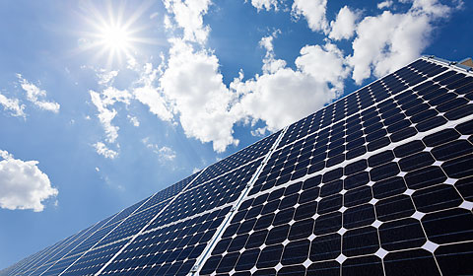
The client - RECAP
Bengt Stridh:
researcher at the Future Energy Center research specialization at MDH
developed detailed models in previous projects to analyze investment decisions for photovoltaic (PV) plants in Sweden, together with his colleagues
the current calculator based on these models is inside an Excel file, which uses built in functions to calculate the results

Slide 3
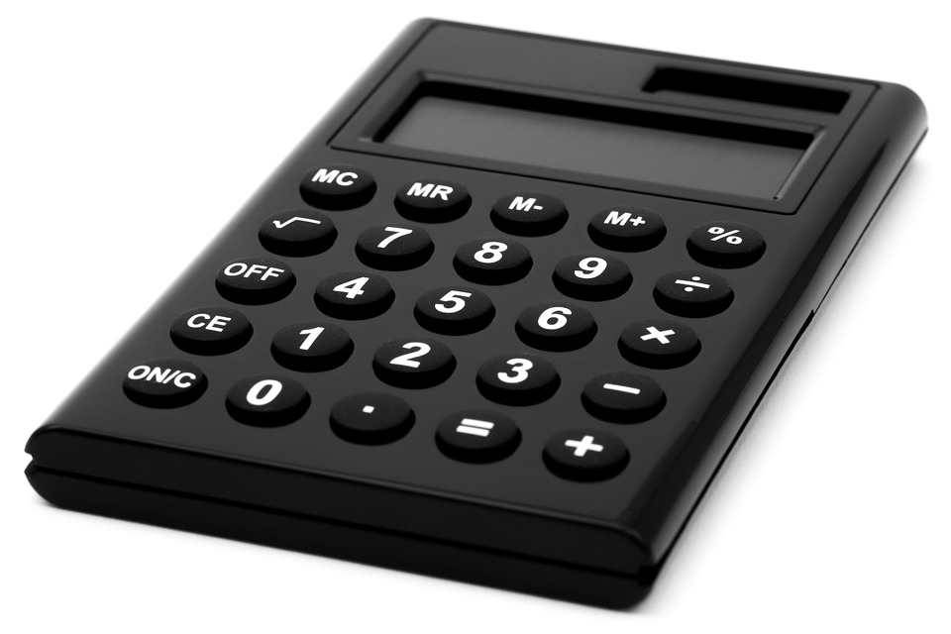
Our task - RECAP
Develop a web-based calculator that helps the users to determine what investments in solar energy that are suitable for them
The potential users are private persons and others (e.g. companies, property owners and cities)

Slide 4
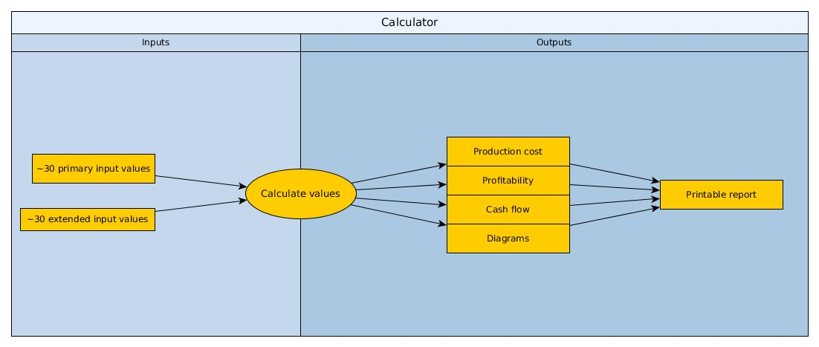
The system (web-based calculator) - RECAP

Slide 5
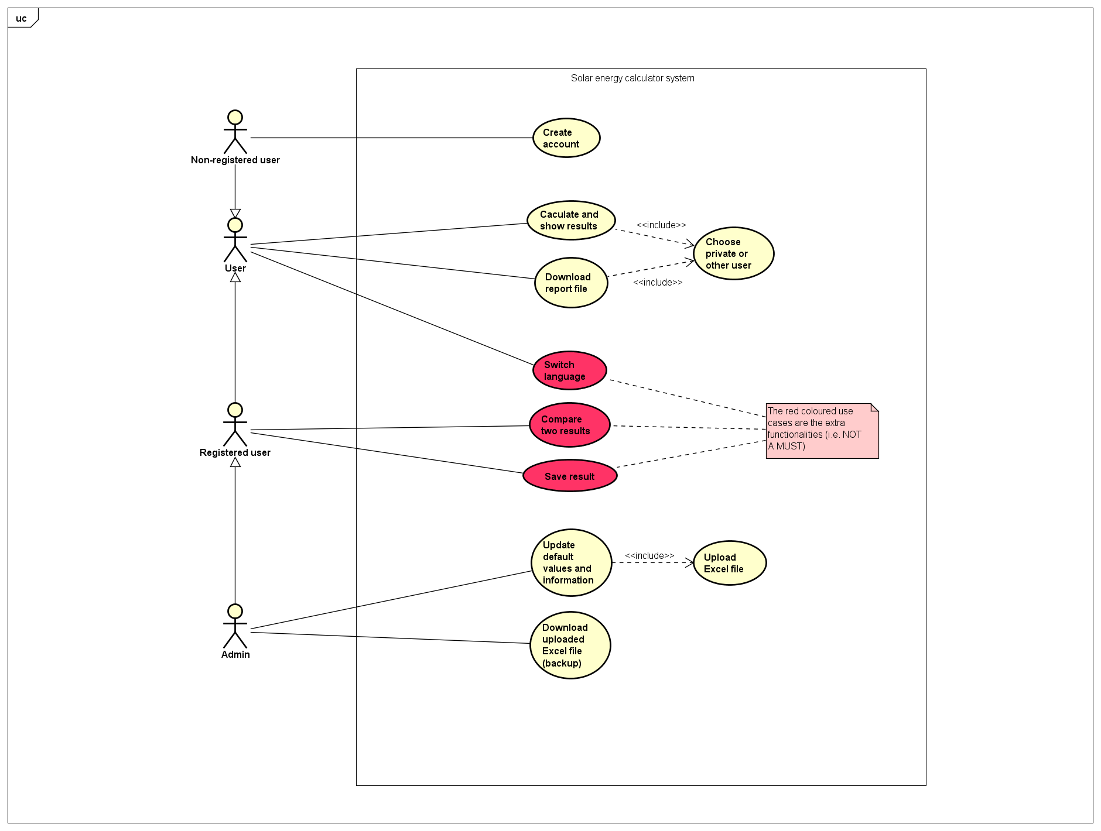
Functionalities - RECAP

Slide 6




Our progress
Invested hours
Cups of coffee
Amount of meetings
Lines of code
340
65
18
5 200

Slide 7
Important events since the previous presentation
Client’s feedback on our demo website:
Satisfied with the work done so far
Suggested improvements:
Come up with a better product name (e.g. Solar Economy Calculator)
Format the numerical input values (e.g. 1200000 => 1 200 000)
Explain how and why to create an user account
Add step-by-step instructions on how to use the calculator
Add a dictionary for unusual words
Add explanations of the formulas
Correct some spelling mistakes
Add/remove text
...
Notes:
OLD TEXT (don’t know if this really needs to be mentioned):
We are working on the project plan according to the feedback given by steering group.
We have written a design description
Purpose: Give a potential new member or product evolution group a good introduction to and description of the project
To mainly get a clear view on the implementation phase .

Slide 8

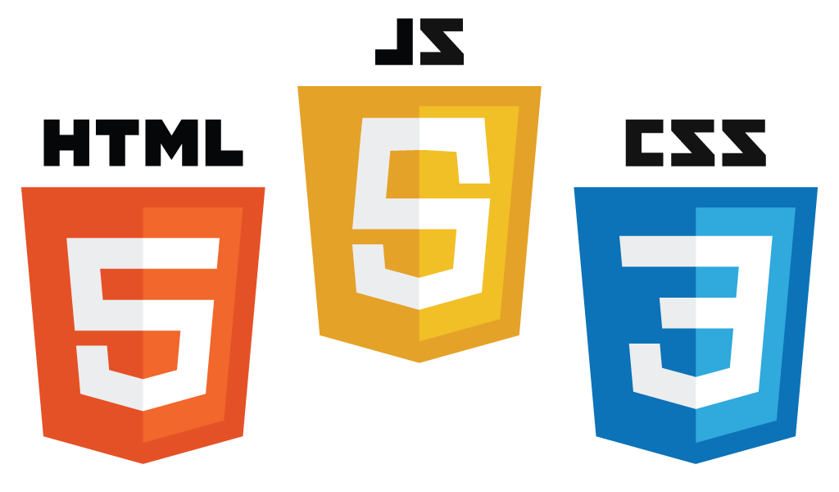




Web technologies to be used

Slide 9
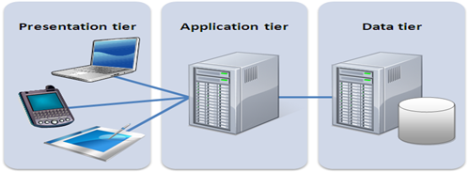
Three-tier architecture
Pros of using the three-tier architecture:
More secure
Easily scalable
Easily maintained

Slide 10

Design decisions
The three-tier architecture is also commonly used for web-applications
We chose to use a database because the client wanted the following requirements:
Update default values, guiding texts etc. by uploading an Excel file (admin only)
Switch language between Swedish and English (all users)
Save results (registered users)
Compare two results (registered users)
Notes:
OLD TEXT:
1.The system must be User friendly.
2.The UI should be sleek and modern
3.The system should help the user to do good decisions
4.The output should be easily accessible and understandable

Slide 11
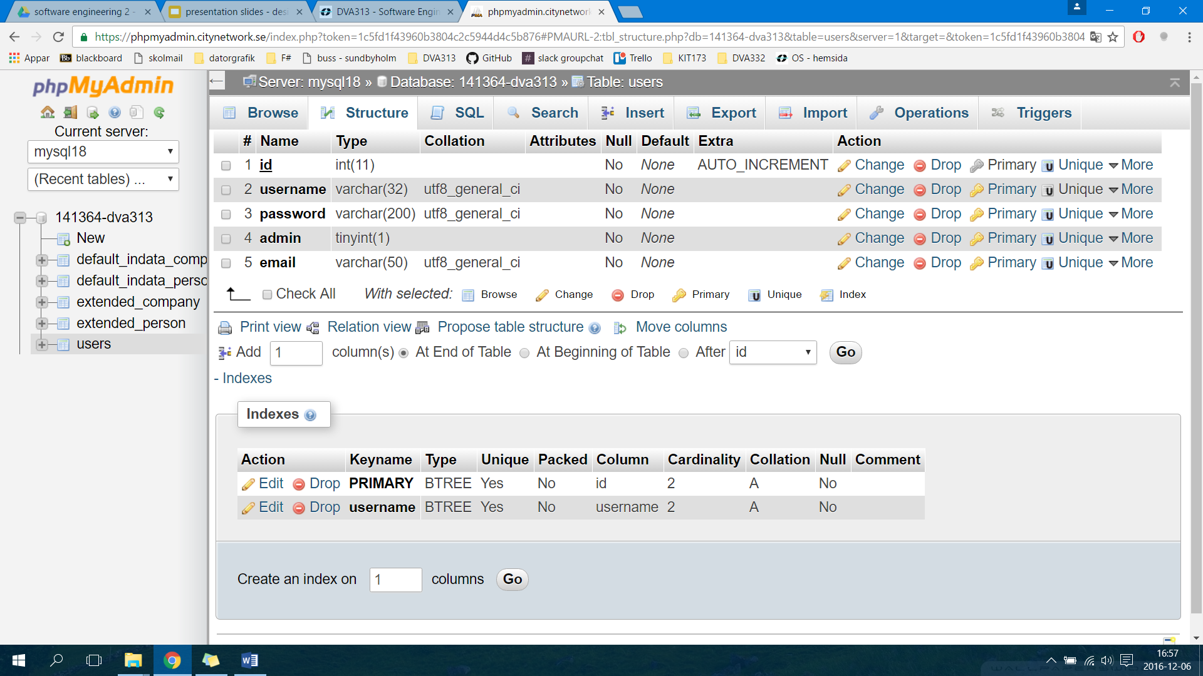
Database table - User login
OBS. We might add another field for knowing if the registered user is a private person or other user (e.g. company)

Slide 12
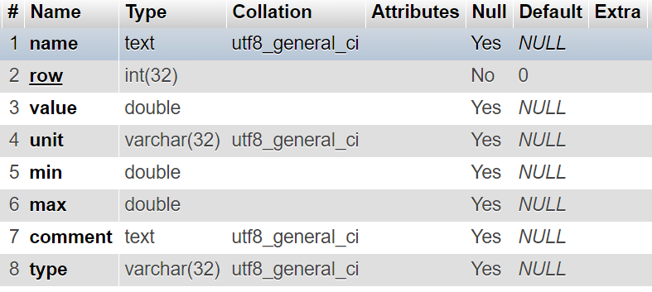
Database table - Input parameters
OBS. Same kind of database table for both the default and extended input parameters
one each for both the private persons and other users
Notes:
We will probably add a second field for the name and comment (one for swedish and one for english).

Slide 13
The implementation so far (live demo)
We will now show you a simple demo website that we have created so far.
Notes:
show the database’s tables, e.g. what the fields contain, on www.myphpadmin.net?

Slide 14
Plans for the rest of the project
Main features to implement:
Correct calculations (production cost, profitability, cash flow)
Make diagrams and tables show the result
Possibility to download a report file (PDF)
Save and compare calculated results
Switch languages
Add more database tables (e.g. for saved values/results)
Account registration
Testing
Unit testing as soon as functionalities have been implemented
Integration testing when all of the “related” functionalities have been implemented
User testing (client and other external people) when the complete system is done
Notes:
OLD TEXT:
1.The system must be User friendly.
2.The UI should be sleek and modern
3.The system should help the user to do good decisions
4.The output should be easily accessible and understandable

Slide 15
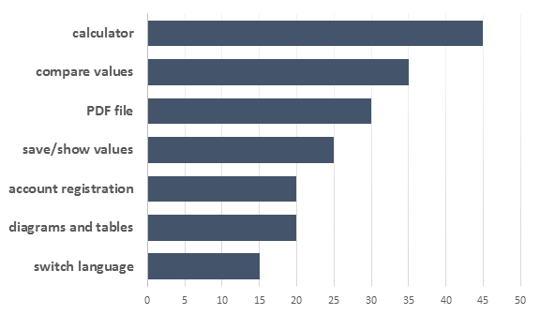
Estimated implementation time for remaining features
Notes:
OLD TEXT:
1.The system must be User friendly.
2.The UI should be sleek and modern
3.The system should help the user to do good decisions
4.The output should be easily accessible and understandable

Slide 16
Other things worth to mention
We might add some functionality for taking into account the amount of solar energy that is in different parts of Sweden - only if there is time left, and it will also require more discussions with the client for a solution

Slide 17

ANY QUESTIONS?

